Slide 1
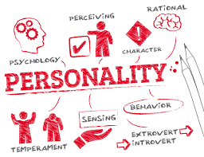

Slide 2
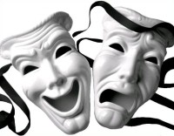
Term personality has been derived from Latin word ‘Persona” which means false appearance with the help of artificial dress and masks while acting out their role on the stage.

Slide 3
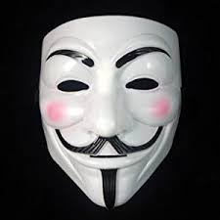
But slowly and slowly word persona became popular in common with the actor and actresses and as a result , a layman’s concept of personality refers to the physical appearance of a person.

Slide 4
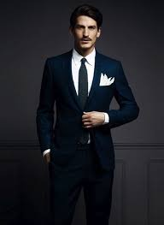

Generally, people mean by personality, it is the attractiveness of an individual or the outer physical appearance an individual holds.

Slide 5
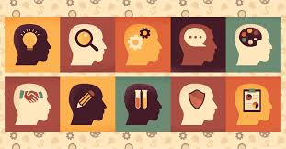
Psychologically speaking, personality is the sum total of all that an individual is, of everything that constitutes a persons physical , mental, emotional and temperamental makeup.

Slide 6
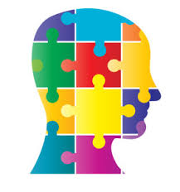
Our experiences, memories, knowledge, study, learning , habits, thoughts, attitudes and beliefs, sentiments, goals and ideals, in fact all that we are and all that we hope and aspire to become, constitute our personality

Slide 7
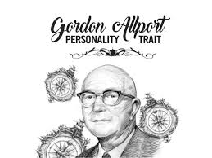
According to Allport-
Personality is a dynamic
organisation within the individual
of those psychophysical systems that determine his unique adjustment to his environment

Slide 8
Personality psychology is the study of each person’s characteristics as they make him different from others and consistent within himself.
Personality is not a quantifiable attribute . We can’t say this person is having more personality or no personality.

